Slide 1
BLOOM
#OkBloomer
By the Dark Forest Dev Team
Twitter: @bloomdefi
discord.gg/bloomdefi

Slide 2

SECURITY
01
KYC
02
DOXX
#OkBloomer
03
AUDIT
04
CONTRACT OWNER
05
MULTISIG

Slide 3
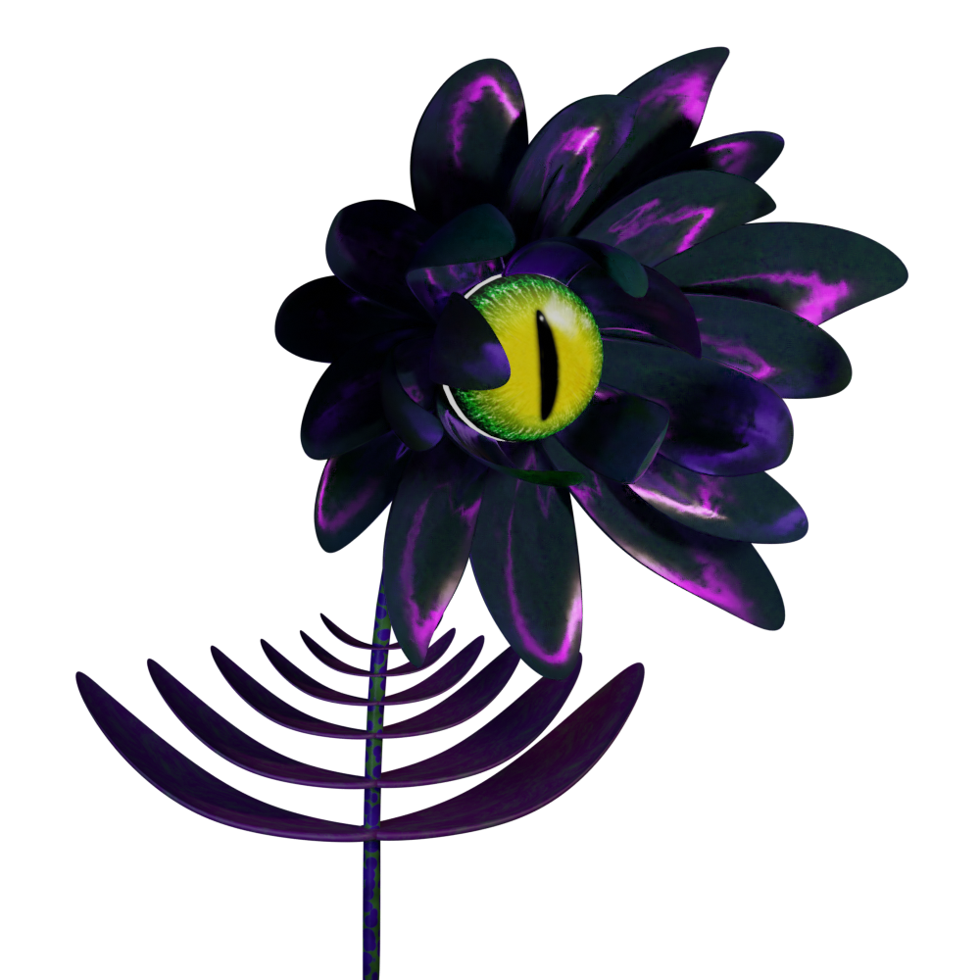
BLOOMBOX
BLOOMIFY
BLOOM.
ABOUT THE TEAM
Vision
Grand Ecosystem
Evolved protocols & New innovative ones
One stop shop
Cross Chain
Utilities
Treasury building and investing
Trust & Transparency
#OkBloomer
BLOOM
Notes:
The main objective of the Bloom team is to create a grand ecosystem that all investors can call home. The Team wants to create a haven for investors to call home. Helping to avoid spreading their hard-earned money to thin. The Bloom Team’s development goals are to evolve existing protocols, as well as building new and exciting original smart contracts. This development goal makes, The BLOOM Ecosystem, one of the most promising projects in DeFi. A one stop shop for seamless cross chain utility, passive income, hyper treasury building, statistical treasury management, Trunk Bank, cross chain Dex, treasury backed stablecoin, and cross chain NFT marketplace. The Dev Team will always be committed to looking into new and exciting DeFi innovations that can benefit our community and ecosystem.

Slide 4


BLOOMIFY.
BLOOM REFERRAL
Fresh & Innovative
STABLE TOKEN REWARDS – USDC.e
HYPERBUILDING TREASURY
0.5% (SOLO) - 1% (TEAM) DAILY APR!
EARN MORE REWARDS BY REFERRING NEW USERS WITH A REFERRAL CODE
USE BLOOMIFY NFTs TO ACCESS DOWNLINE REWARDS
#OkBloomer
BLOOMIFY
Notes:
STABLE TOKEN REWARDS: No other referral system in DeFi offers these kind of rewards. Creating positive buying pressure and limiting selling pressure on native rewards token $NCTR
HYPERBUILDING TREASURY – Buy in with USDC.e and the contract swap 50% of the USDC.e to NCTR. The other 50% of USDC.e goes to build the treasury.
0.5% (SOLO) - 1% (TEAM) DAILY APR!
EARN MORE REWARDS BY REFERRING NEW USERS WITH A REFERRAL CODE. USE NFTs TO ACCESS DOWNLINE REWARDS
Boost reward with Deer/Predator NFT collection. Also benefits from weekly airdrop, every Sunday, from 10% of that weeks Treasury gains.

Slide 5
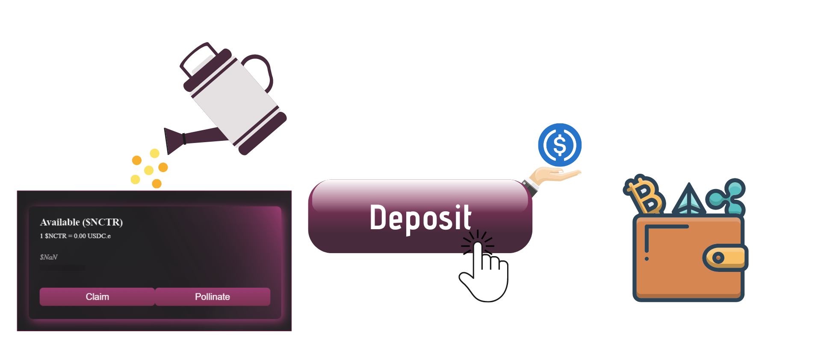
HOW TO BENEFIT
FROM YOUR DOWNLINE DEPOSITS
1
DEPOSIT REWARDS
#OkBloomer
Notes:
CREATING A TEAM: TEAM BUILDING WILL DRAMATICALLY ACCELERATE YOUR ROI PERIOD. ALLOWING YOUR TEAM’S CHAIN TO GROW ORGANICALLY, WHILE INCREASING YOUR $NCTR HOLDINGS IN FLOWER VALUE. WITH THE ADDED BENEFIT OF RECEIVING STABLE TOKENS.
BLOOM PLANS TO MAXIMIZE RETURNS BY FOCUSING ON REAL WORLD ADOPTION. ECOSYTEM GOALS ARE ACHIEVED BY BUILDING OUT COMMUNITY TEAMS THROUGH DIRECT REFERRALS. THIS RESULTS IN HYPER TREASURY GROWTH. ALLOWING THE ECOSYTEM TO INVEST INTO ON CHAIN ASSETS, AND TRUE OFF CHAIN INVESTMETS, TO GIVE OUR ECOSYSTEM A ONE-OF-A-KIND TREASURY BACKED REWARDS SYSTEM.

Slide 6
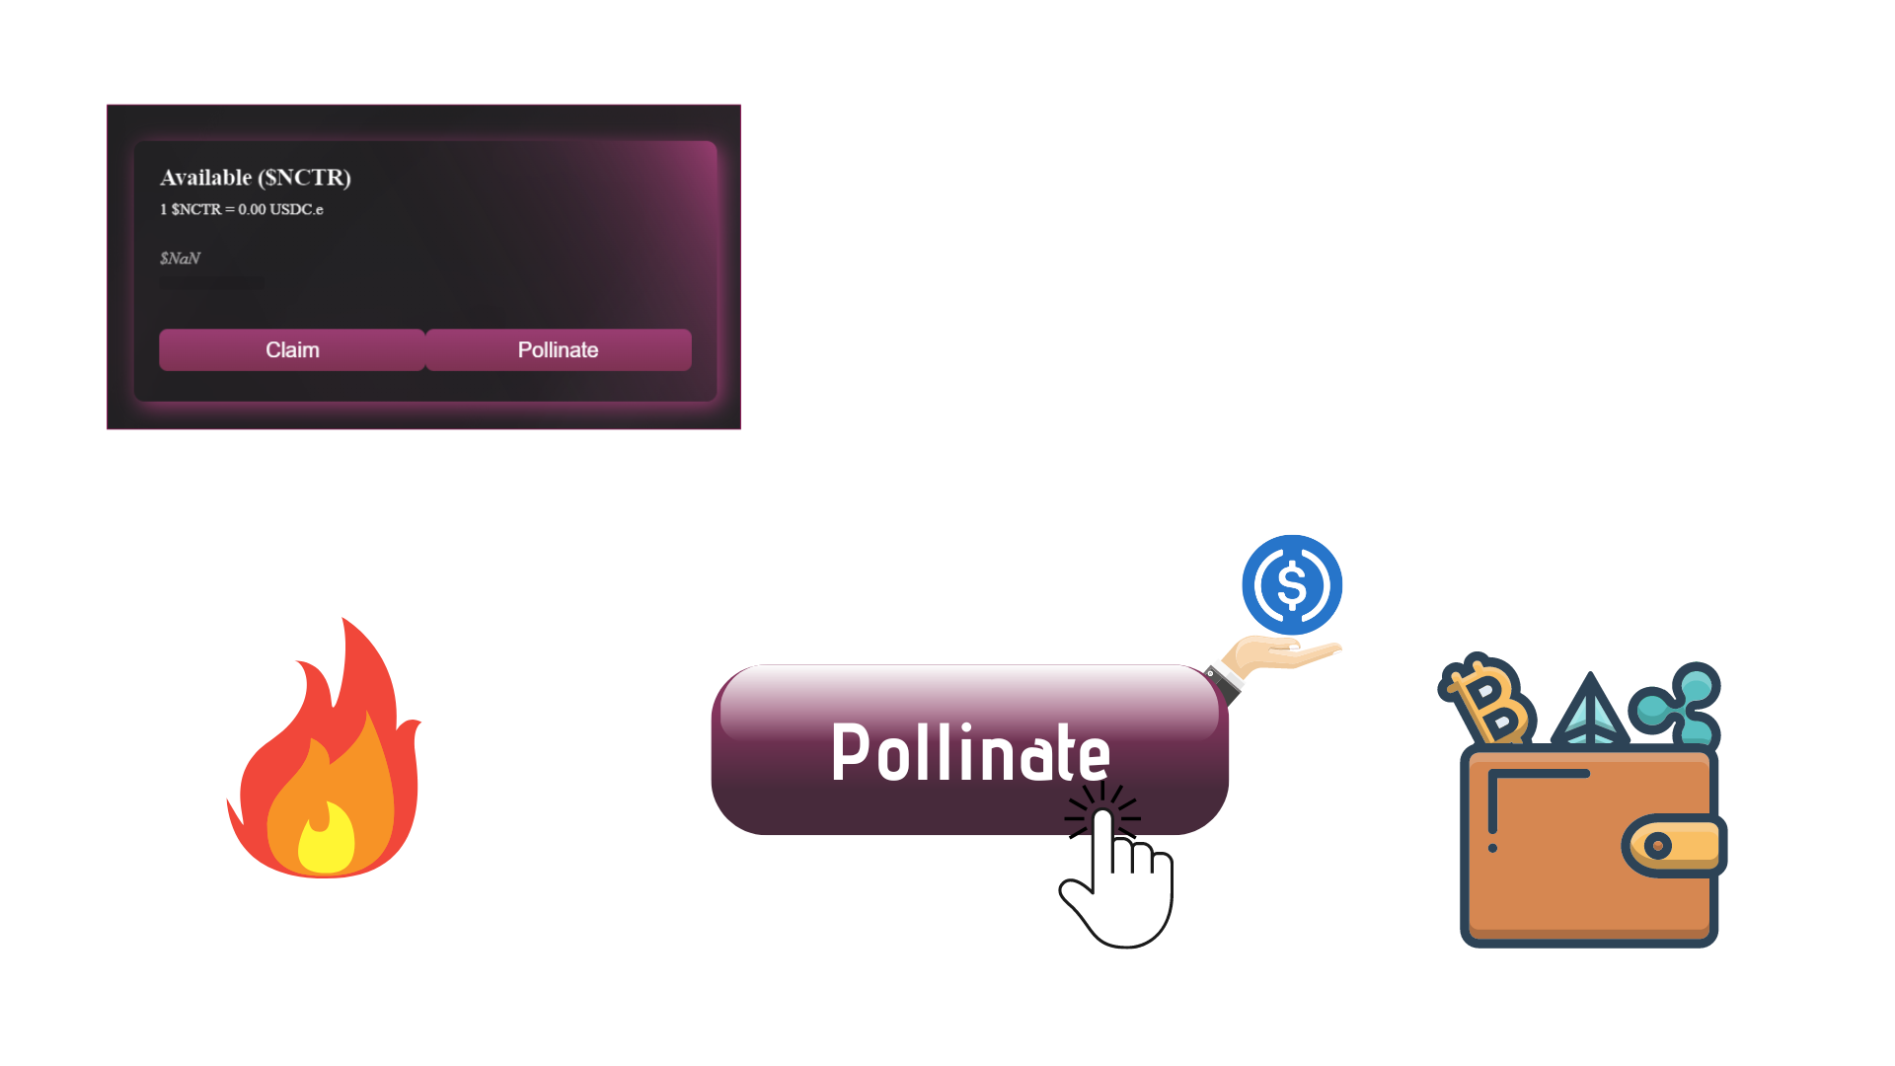
HOW TO BENEFIT
FROM YOUR DOWNLINE POLLINATES
2
COMPOUND REWARDS
#OkBloomer
Notes:
CREATING A TEAM: TEAM BUILDING WILL DRAMATICALLY ACCELERATE YOUR ROI PERIOD. ALLOWING YOUR TEAM’S CHAIN TO GROW ORGANICALLY, WHILE INCREASING YOUR $NCTR HOLDINGS IN FLOWER VALUE. WITH THE ADDED BENEFIT OF RECEIVING STABLE TOKENS.
BLOOM PLANS TO MAXIMIZE RETURNS BY FOCUSING ON REAL WORLD ADOPTION. ECOSYTEM GOALS ARE ACHIEVED BY BUILDING OUT COMMUNITY TEAMS THROUGH DIRECT REFERRALS. THIS RESULTS IN HYPER TREASURY GROWTH. ALLOWING THE ECOSYTEM TO INVEST INTO ON CHAIN ASSETS, AND TRUE OFF CHAIN INVESTMETS, TO GIVE OUR ECOSYSTEM A ONE-OF-A-KIND TREASURY BACKED REWARDS SYSTEM.

Slide 7
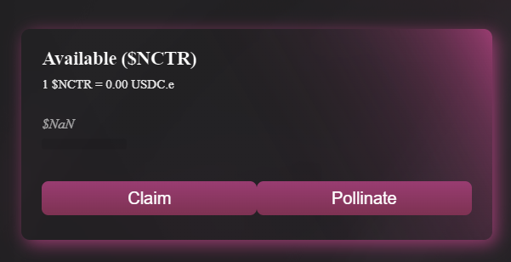
DAILY APR
PASSIVE INCOME
0.5%
SOLO
You can participate in Bloomify without referring others. If this is your choice, you’ll get a stable daily APR of 0.5%.
#OkBloomer
1%
TEAM
Create a team – Minimum 5 direct referrals to earn the team wallet status. By doing this, you are rewarded with a stable daily APR of 1%.
BLOOMIFY

Slide 8
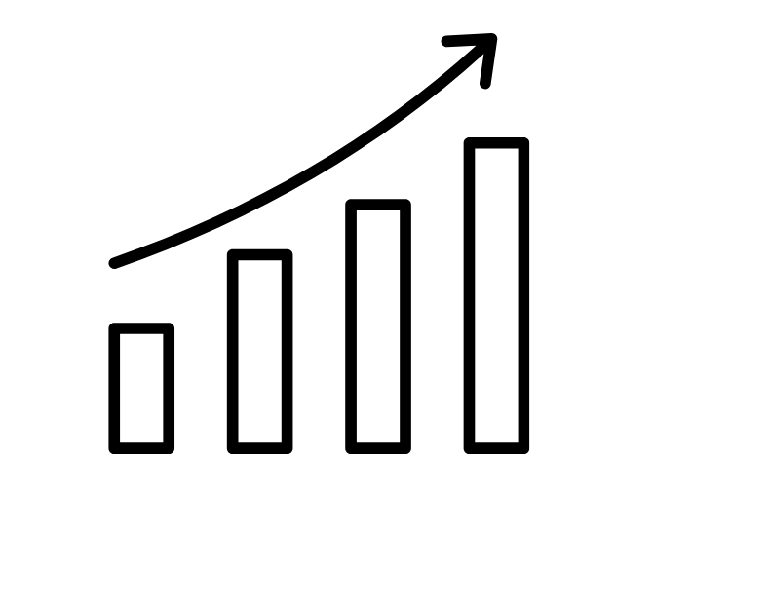
POLLINATE.
How it works
01
Compound/Claim ratio
02
1 Action every 24h
#OkBloomer
Manually executed
03
Pollination from downline
04
Calculate your compounding
Notes:
CREATING A TEAM: TEAM BUILDING WILL DRAMATICALLY ACCELERATE YOUR ROI PERIOD. ALLOWING YOUR TEAM’S CHAIN TO GROW ORGANICALLY, WHILE INCREASING YOUR $NCTR HOLDINGS IN FLOWER VALUE. WITH THE ADDED BENEFIT OF RECEIVING STABLE TOKENS.
BLOOM PLANS TO MAXIMIZE RETURNS BY FOCUSING ON REAL WORLD ADOPTION. ECOSYTEM GOALS ARE ACHIEVED BY BUILDING OUT COMMUNITY TEAMS THROUGH DIRECT REFERRALS. THIS RESULTS IN HYPER TREASURY GROWTH. ALLOWING THE ECOSYTEM TO INVEST INTO ON CHAIN ASSETS, AND TRUE OFF CHAIN INVESTMETS, TO GIVE OUR ECOSYSTEM A ONE-OF-A-KIND TREASURY BACKED REWARDS SYSTEM.

Slide 9
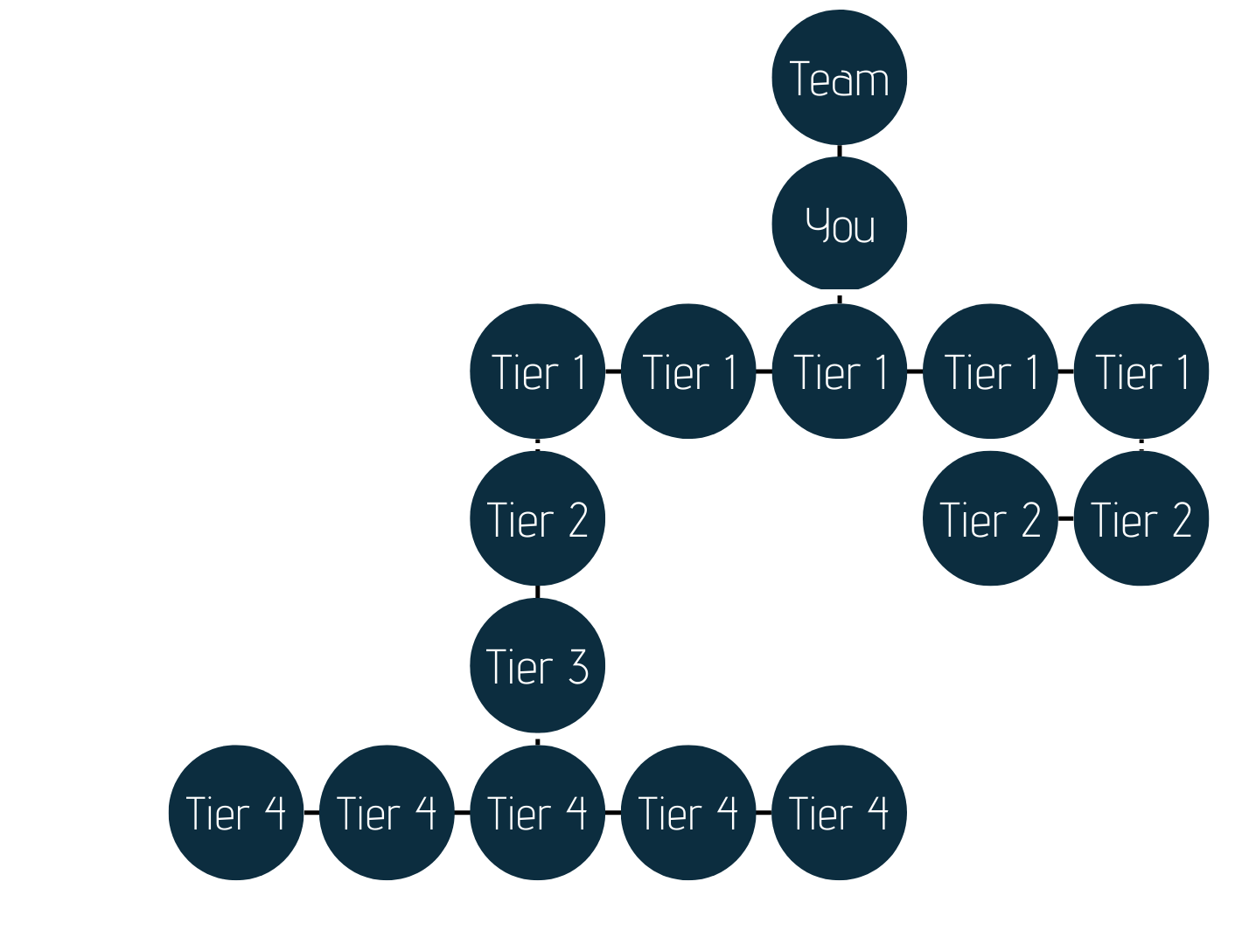
REFERRING
EARN MORE BY REFERRING
Do you need a team?
Benefits of creating a team
How to become a team wallet
Airdropping your team
#OkBloomer

Slide 10
CLAIMING.
How it works
01
Positive Net Deposit Value
= Deposit + Airdrop (sent and received) + Pollinates - Claims
02
Create your own claim/compound strategy
#OkBloomer
Delayed gratification vs immediate claim
03
Max payout of 365% (3.65 x Deposits)
Initial deposit + future deposits + pollinates + rewards to deposit area from downline (deposit tax & pollinate tax)
Notes:
CREATING A TEAM: TEAM BUILDING WILL DRAMATICALLY ACCELERATE YOUR ROI PERIOD. ALLOWING YOUR TEAM’S CHAIN TO GROW ORGANICALLY, WHILE INCREASING YOUR $NCTR HOLDINGS IN FLOWER VALUE. WITH THE ADDED BENEFIT OF RECEIVING STABLE TOKENS.
BLOOM PLANS TO MAXIMIZE RETURNS BY FOCUSING ON REAL WORLD ADOPTION. ECOSYTEM GOALS ARE ACHIEVED BY BUILDING OUT COMMUNITY TEAMS THROUGH DIRECT REFERRALS. THIS RESULTS IN HYPER TREASURY GROWTH. ALLOWING THE ECOSYTEM TO INVEST INTO ON CHAIN ASSETS, AND TRUE OFF CHAIN INVESTMETS, TO GIVE OUR ECOSYSTEM A ONE-OF-A-KIND TREASURY BACKED REWARDS SYSTEM.

Slide 11
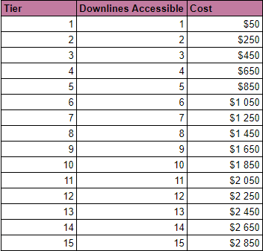
REWARD QUALIFICATION
Bloomify NFTs (Pricing is subject to change)
How to qualify for rewards:
Deposit rewards from downline
Pollinate rewards from downline
Bloomify NFTs
Positive Net Deposit Value (NDV) = Deposit + Airdrop (sent and received) + Pollinates - Claims
#OkBloomer
BLOOMIFY
BLOOMIFY NFT
Notes:
Downline Reward Qualification
COMPOUND
USERS WILL RECEIVE BONUS REWARDS FROM REFERRALS ON THEIR DEPOSITS AND DOWNLINE.
BONUSES FROM PLAYERS REFERAL IS BASED ON THE TIER OF BLOOM NFT HELD IN YOUR WALLET
Downline Reward Qualification DEPOSIT
USERS MUST HOLD AT LEAST A T1 BLOOM NFT, IN ORDER TO BE ELIGIBLE TO RECEIVE DEPOSIT REWARDS FROM THERE DONWLINE DEPOSITS.

Slide 12



#OKBloomer
ACCESIBLE DOWNLINE.
Bloomify NFT – The Butterflies
Tiers: 1-15
Each tier grants you the equivalent level of downline rewards.
Example: Tier 10 Bloomify NFT gives you rewards from 10 levels of depth in the downline
Upgradable - You only need to hold one
Limited supply

Slide 13

HOW TO PARTICIPATE.
BECOME BLOOMER
1
NAVIGATE TO BLOOM WEBSITE
2
INSERT REFERRAL CODE & DEPOSIT USDC.e
#OkBloomer
3
MINT BLOOMIFY NFT FOR REFERRAL BENEFITS
4
SHARE YOUR REFERRAL CODE WITH OTHERS
BLOOMIFY

Slide 14
CALCULATE.
Use the links below to estimate your revenue from your downline’s deposits, and your own pollinating.
Revenue Calculators
Click the buttons below to access the calculators
Pollinating Calculator
Downline Deposit Calculator

